Slide 1


Slide 2
Linux Commands / OTW

Slide 3
Overview
SSH Primer
Overview of some Linux commands
Utilizing Linux on OverTheWire Bandit

Slide 4
SSH Primer

Slide 5
What is SSH?
Secure SHell
secure login from a local computer to a remote computer
shell: takes commands from the keyboard (standard input) and uses the system kernel to execute those commands
cryptographically secure network protocol (TCP port 22)
port number: denotes the software/program that a client computer is attempting to use
ex. HTTPS TCP 443; HTTP TCP 80; DNS UDP 53

Slide 6
SSH cont.
Important: SSH uses TCP port 22 by default/standard
OverTheWire requires a client to connect via SSH, but not on TCP port 22
How do we specify the SSH port?

Slide 7
SSH cont.
Read the manual page for SSH
Specify the correct port for OverTheWire
Use bandit0’s username & password
$ man ssh
http://overthewire.org/wargames/bandit/bandit0.html

Slide 8
Streams & Redirection Primer

Slide 9
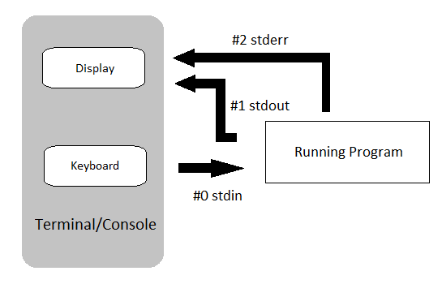
STDIN, STDOUT, STDERR, Pipe/Redirection

Slide 10
STDIN, STDOUT, STDERR
Standard streams
preconnected/predetermined input and output
Standard stream numbers
STDIN 0
STDOUT 1
STDERR 2

Slide 11
Pipe (Shift+\), Redirection (>,>>,<,<<)
Pipe
pass output to a program/system utility
Redirect
pass output to either a file or a (standard) stream

Slide 12
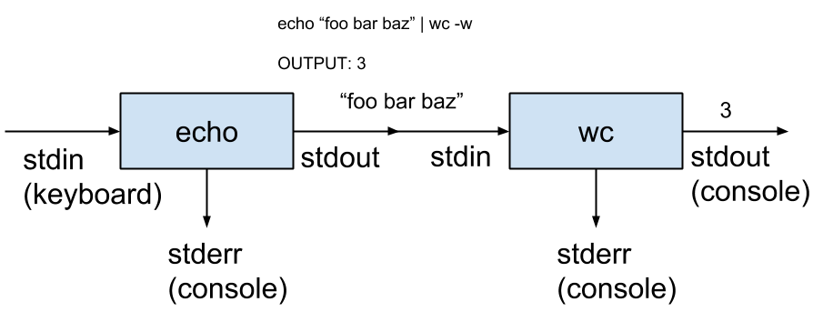
Pipe example

Slide 13
Useful Linux Commands
ls | list files
file | gives type of file
find | find certain files
grep | global regular expression print
sort | print sorted concatenation to stdout
uniq | identify unique adjacent lines
strings | output any printable characters
base64 | encode/decode base64
tr | translate or delete characters

